Slide 1
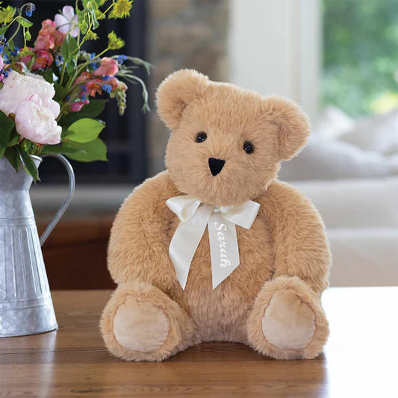
Notes:
Teddy Bear

Slide 2
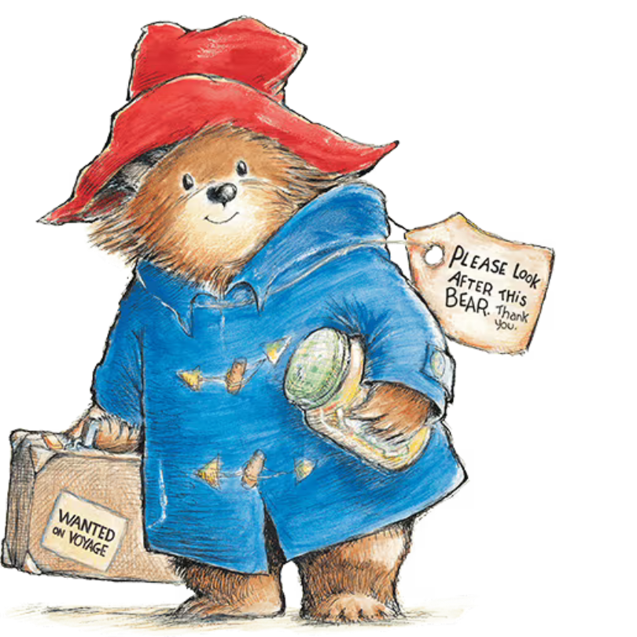
Notes:
Paddington Bear

Slide 3

Notes:
Berkeley

Slide 4
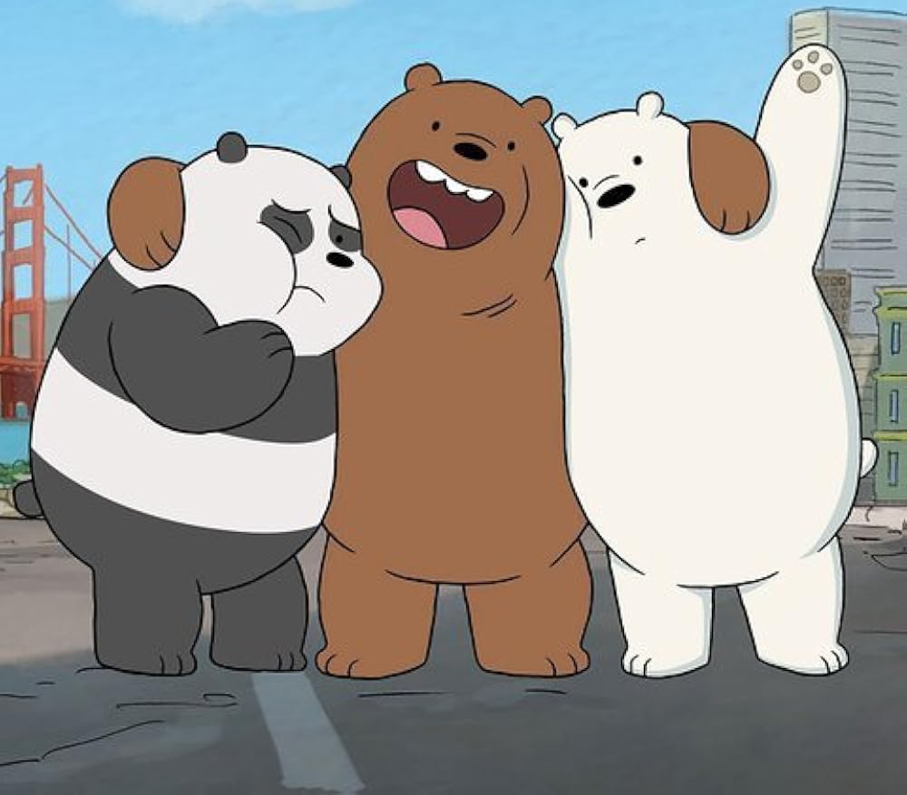
Notes:
We bare bears

Slide 5
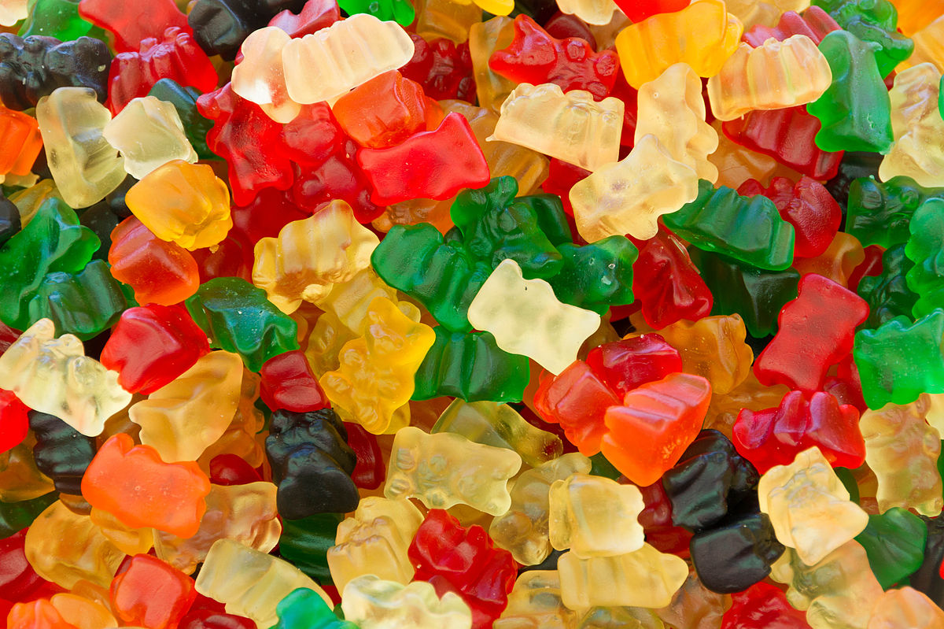
Notes:
Gummy bears

Slide 6
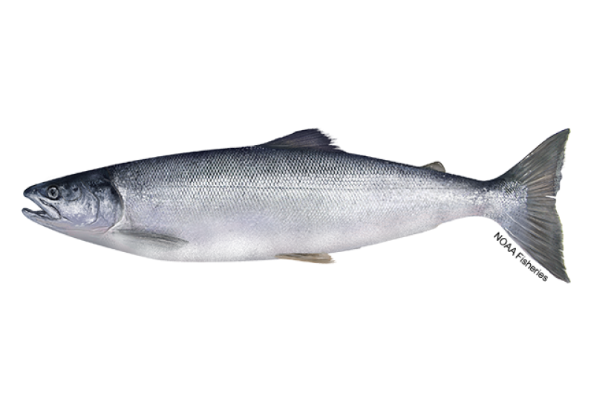
Notes:
salmon

Slide 7
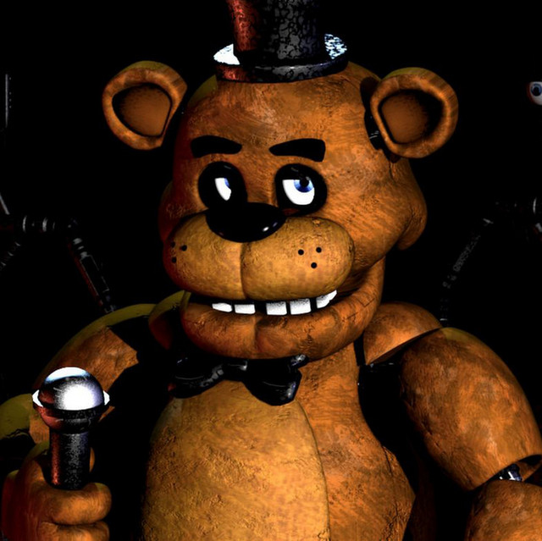
Notes:
Freddy Fazbear

Slide 8
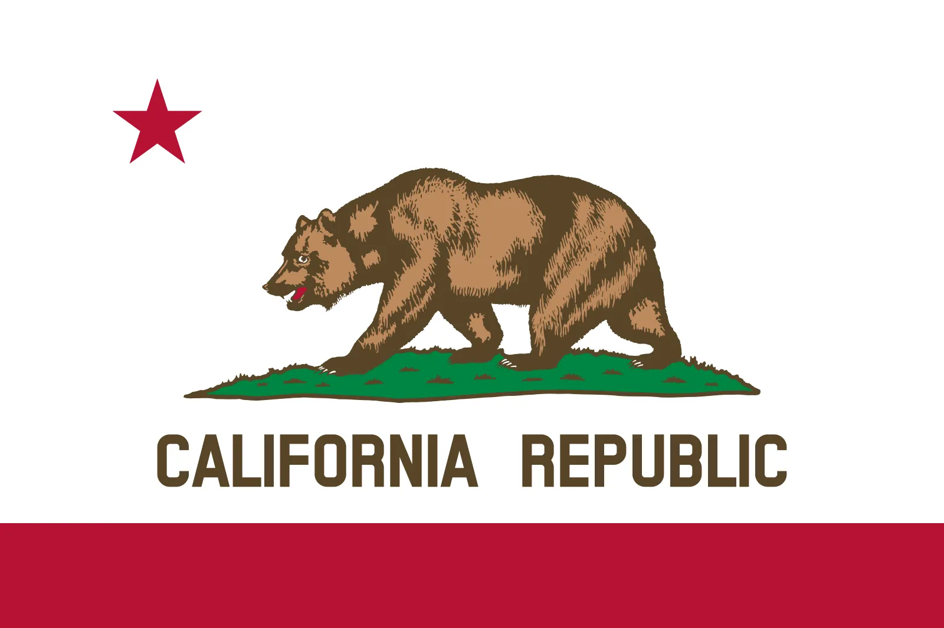
Notes:
California

Slide 9
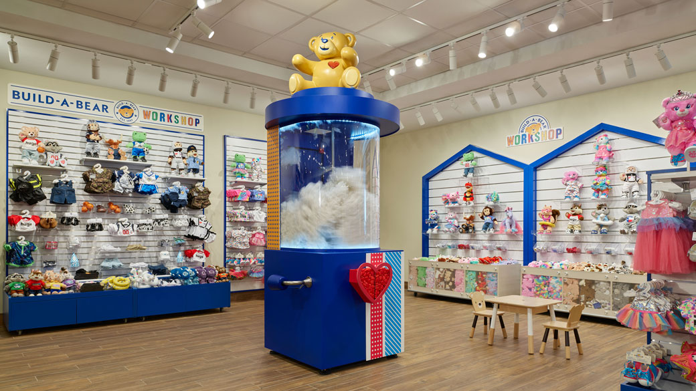
Notes:
Build a bear workshop

Slide 10

Notes:
Da Bears

Slide 11
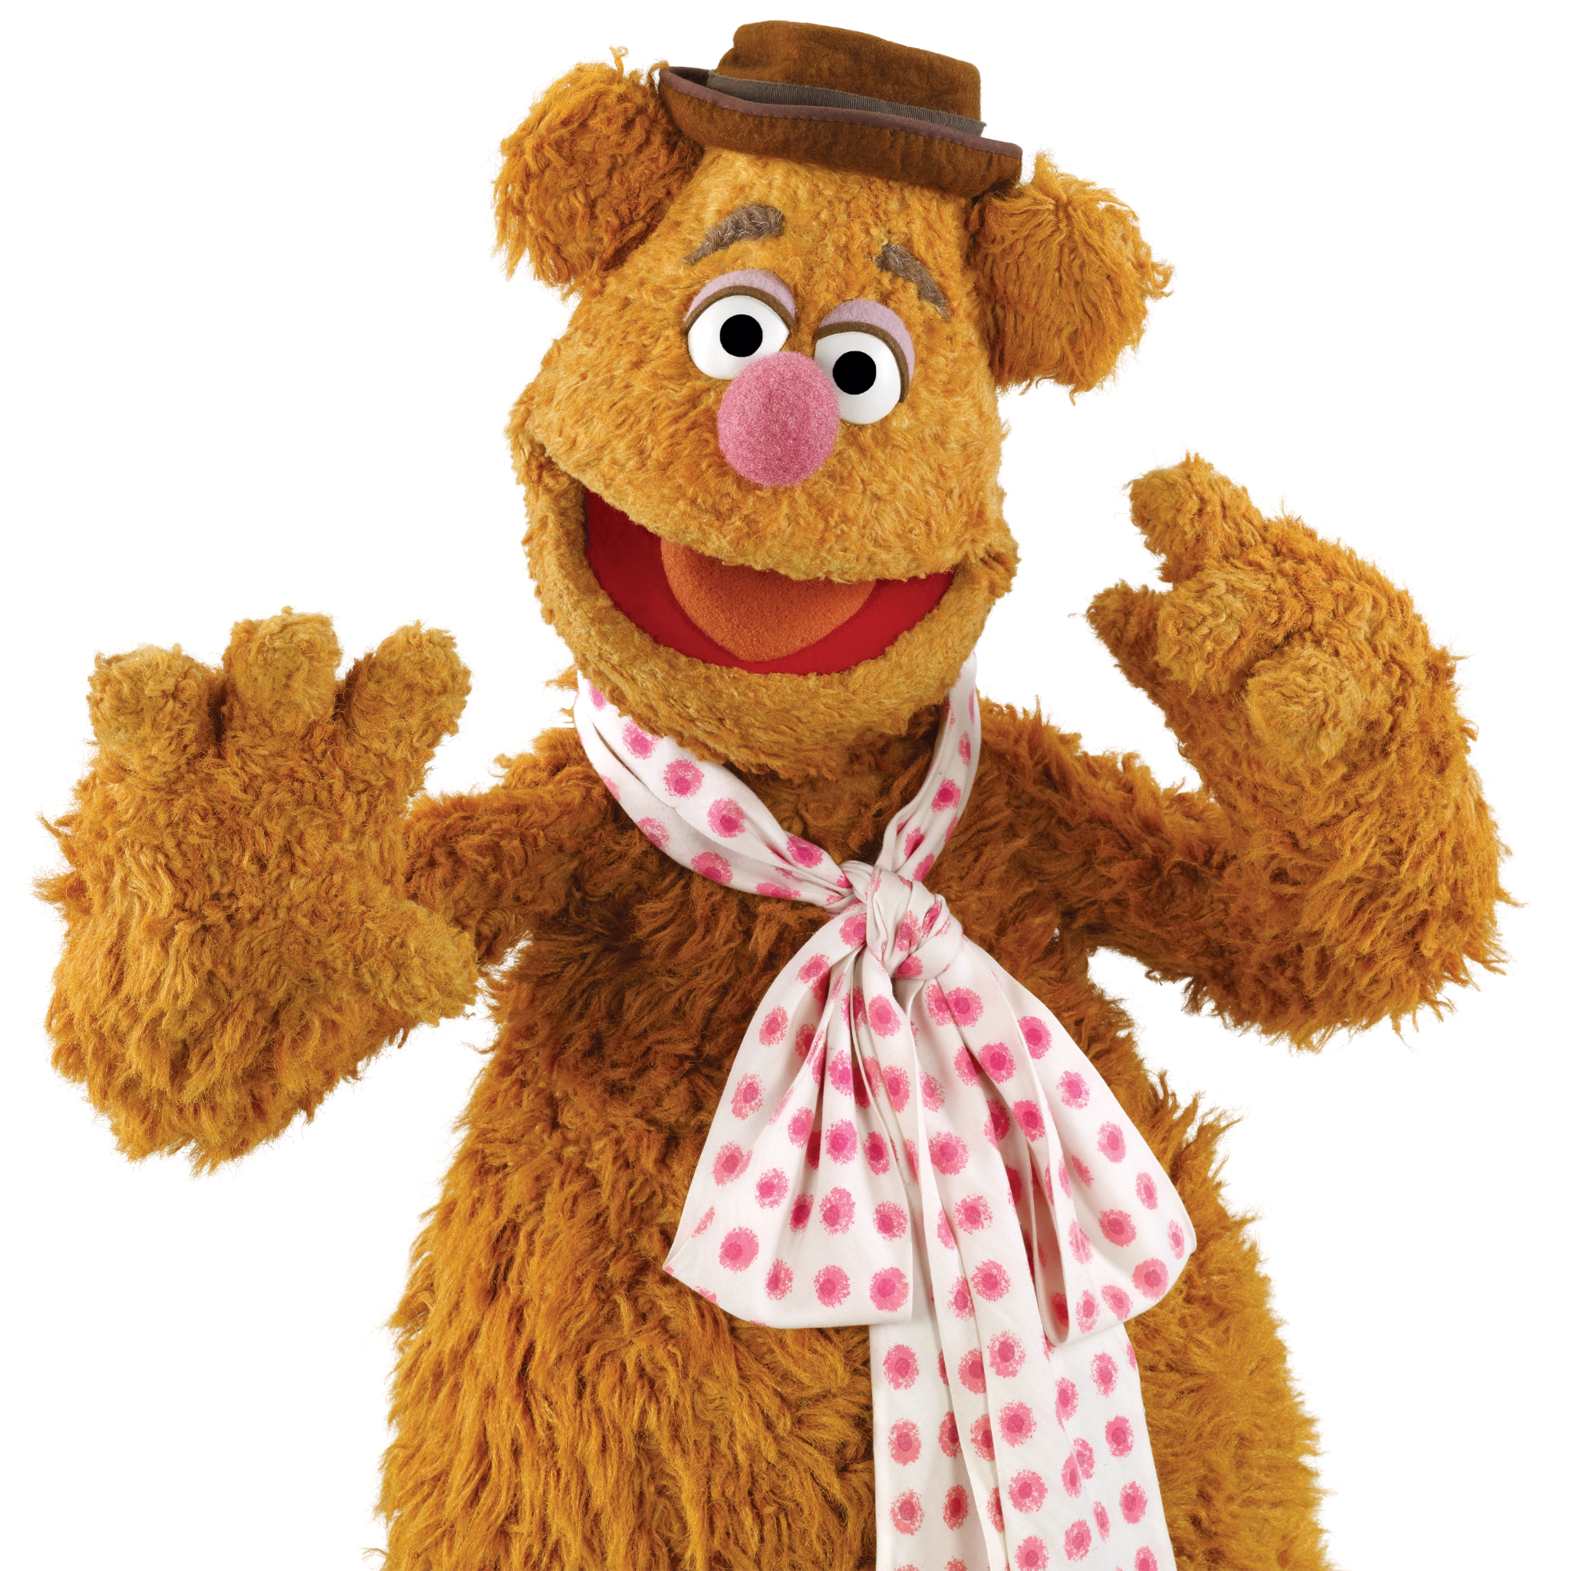
Notes:
Fozzie bear

Slide 12
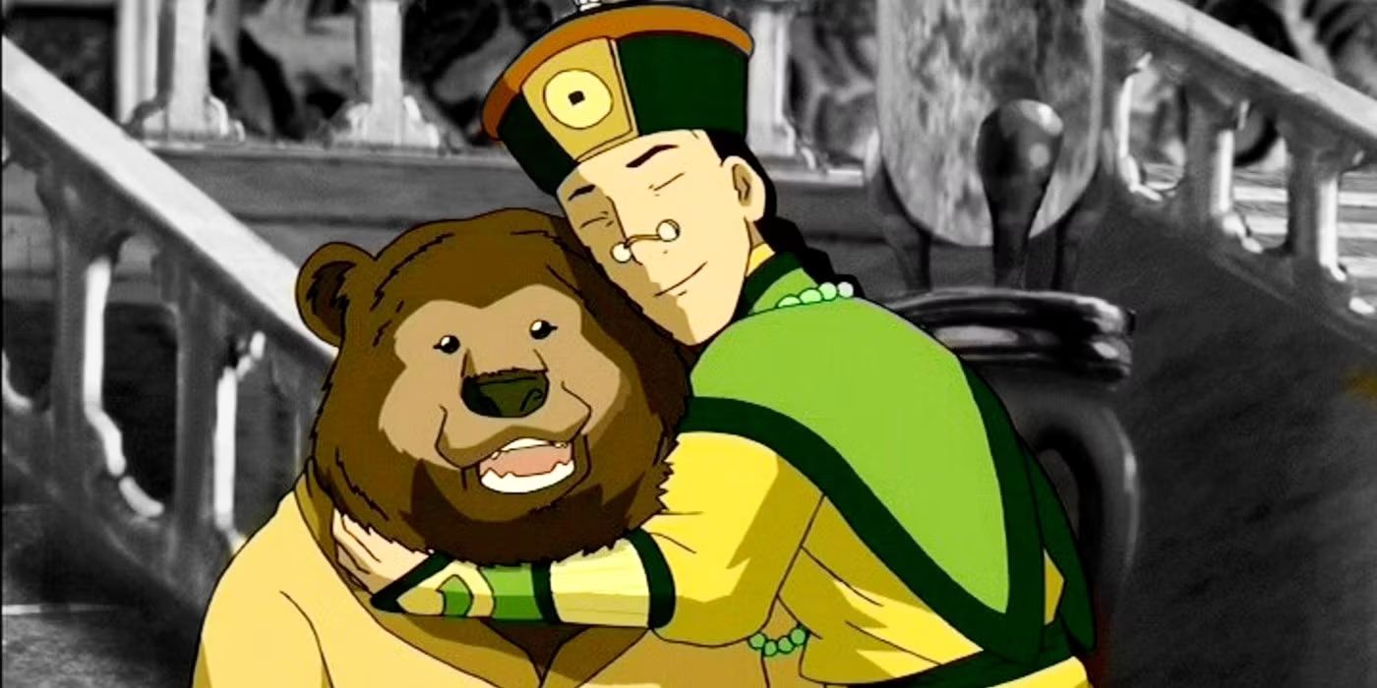
Notes:
Bosco

Slide 13
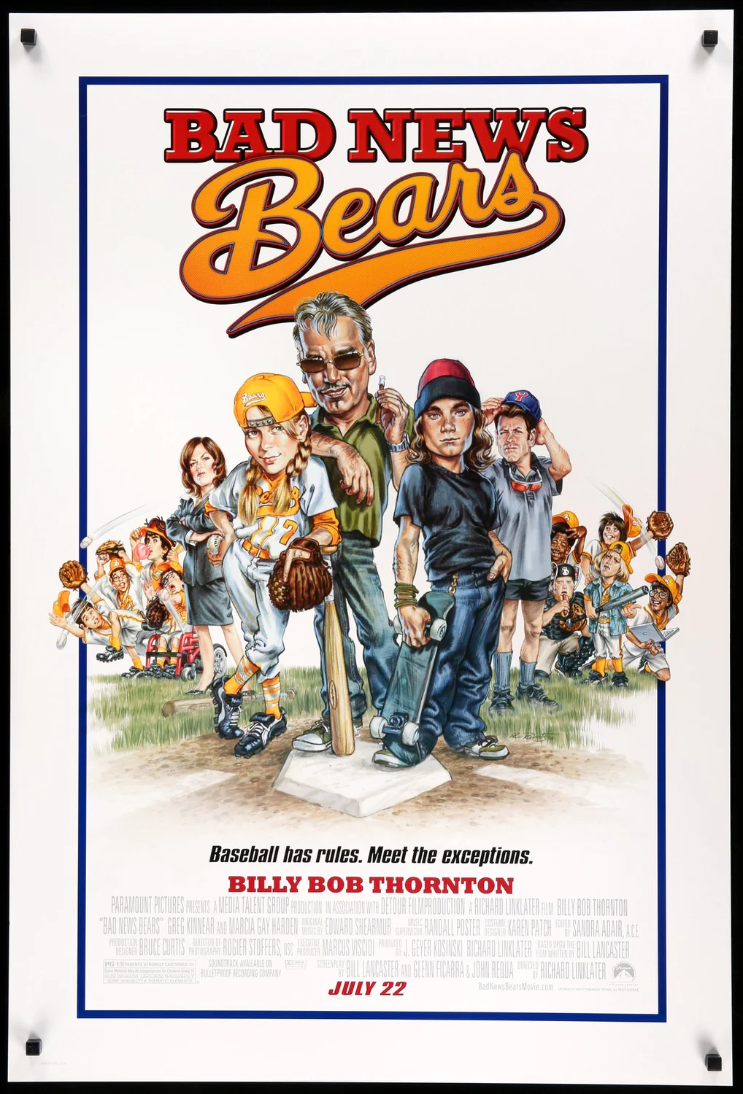
Notes:
Bad News Bears

Slide 14
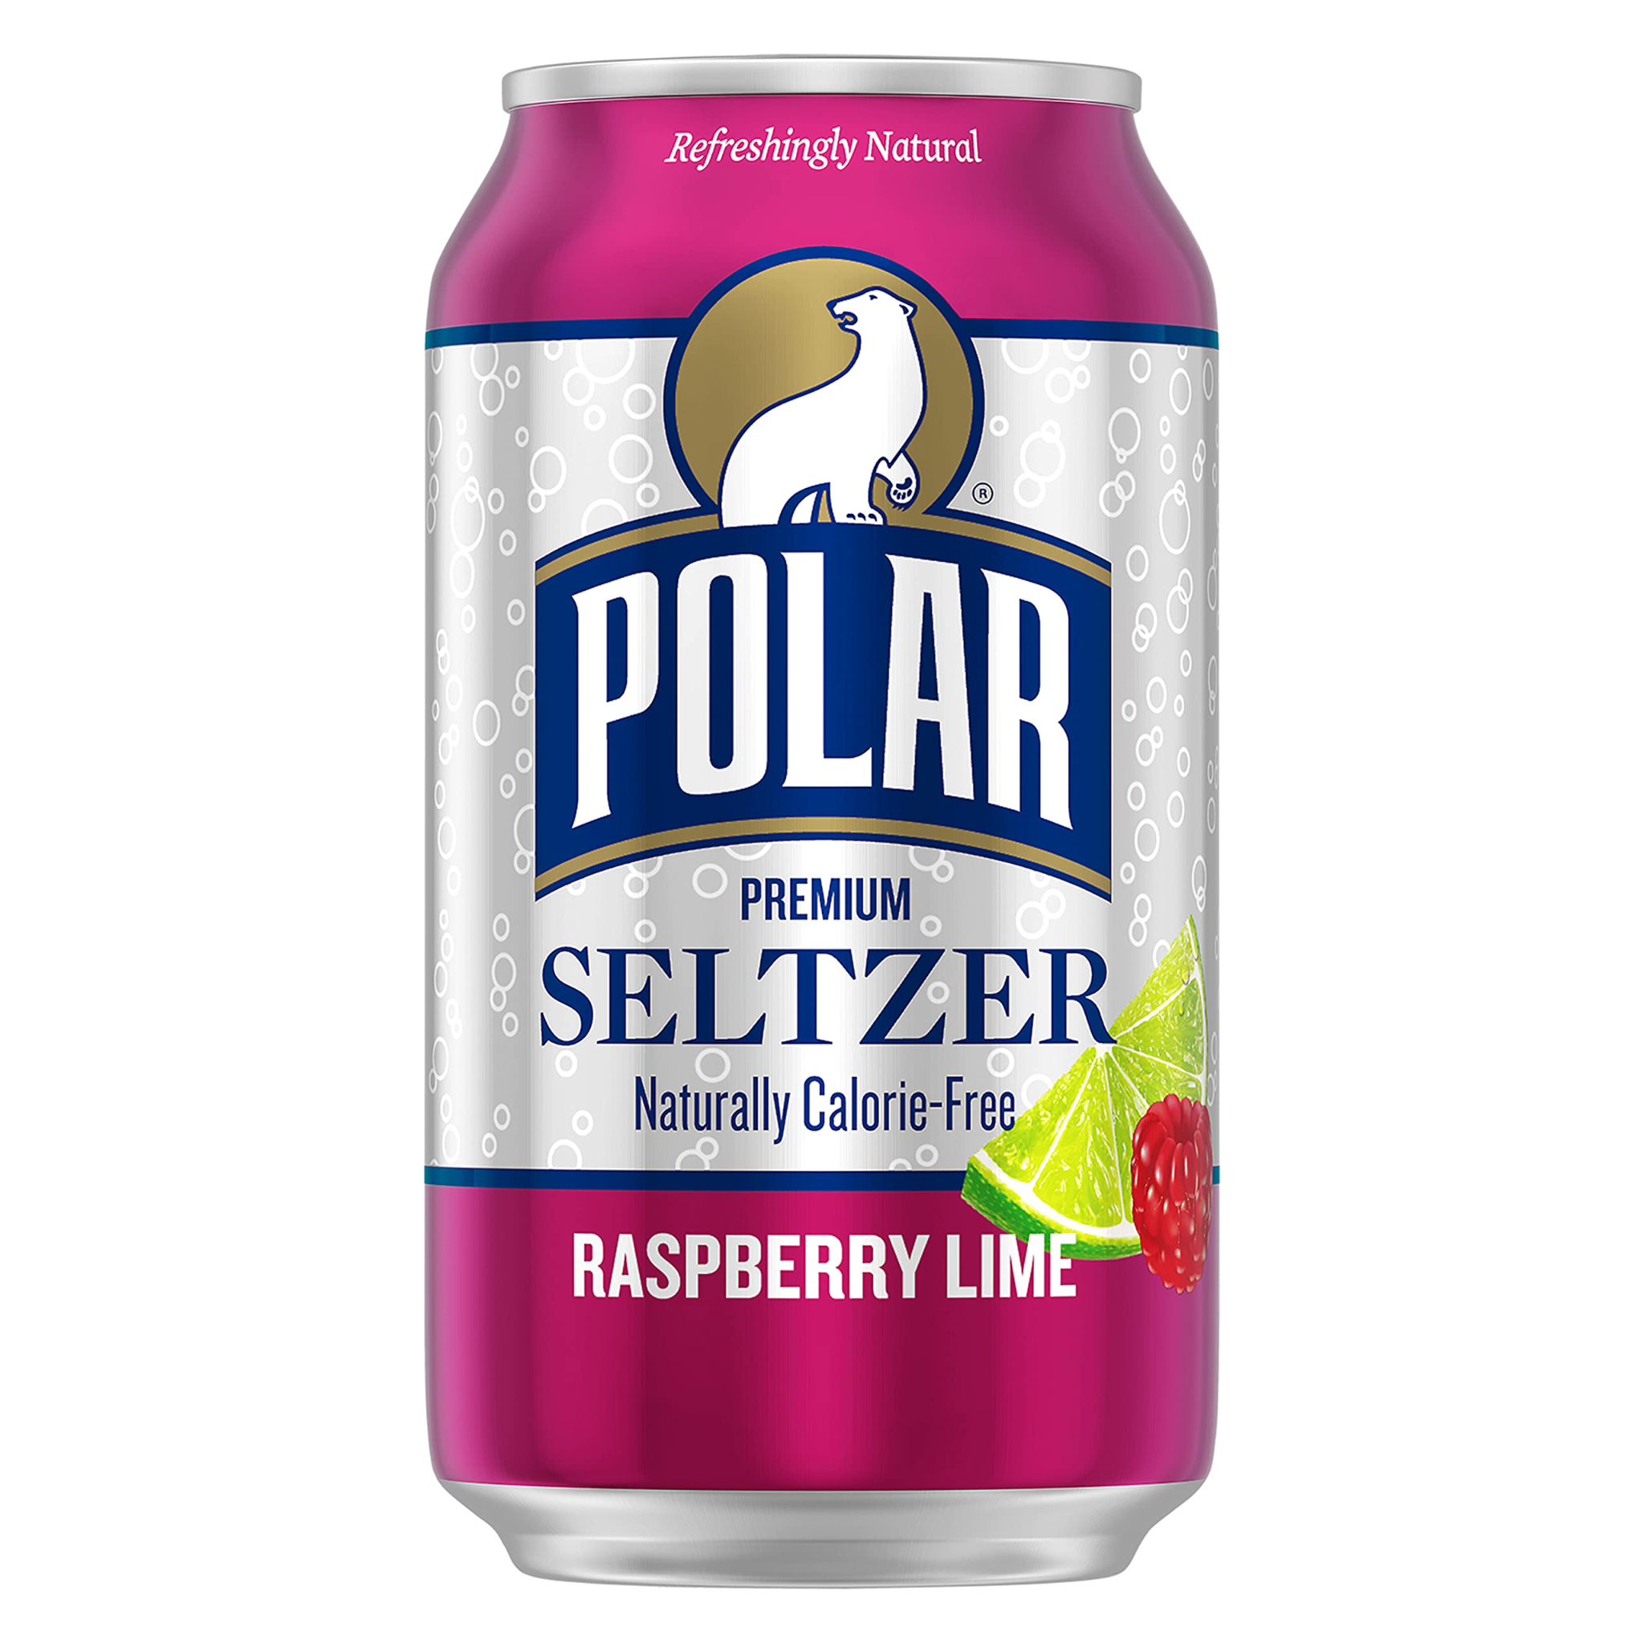
Notes:
Polar seltzer

Slide 15
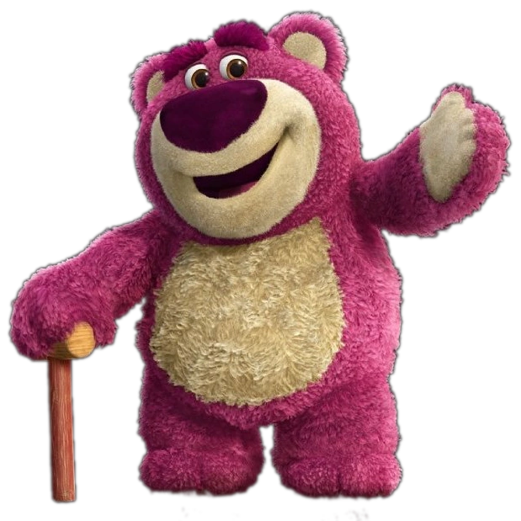
Notes:
Lotso

Slide 16
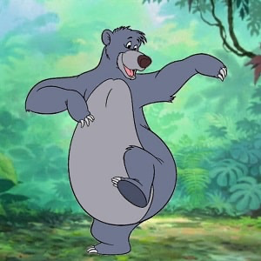
Notes:
Baloo

Slide 17
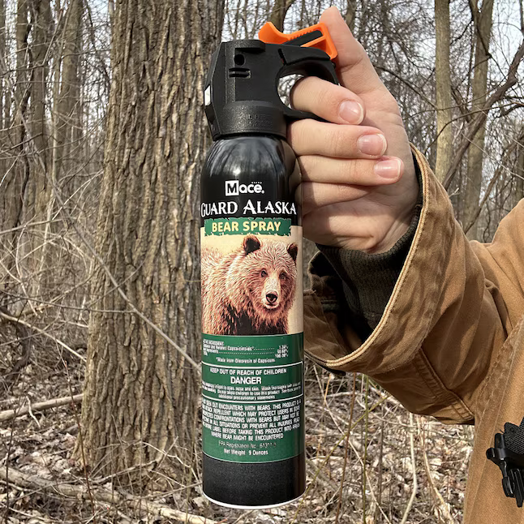
Notes:
Bear spray

Slide 18
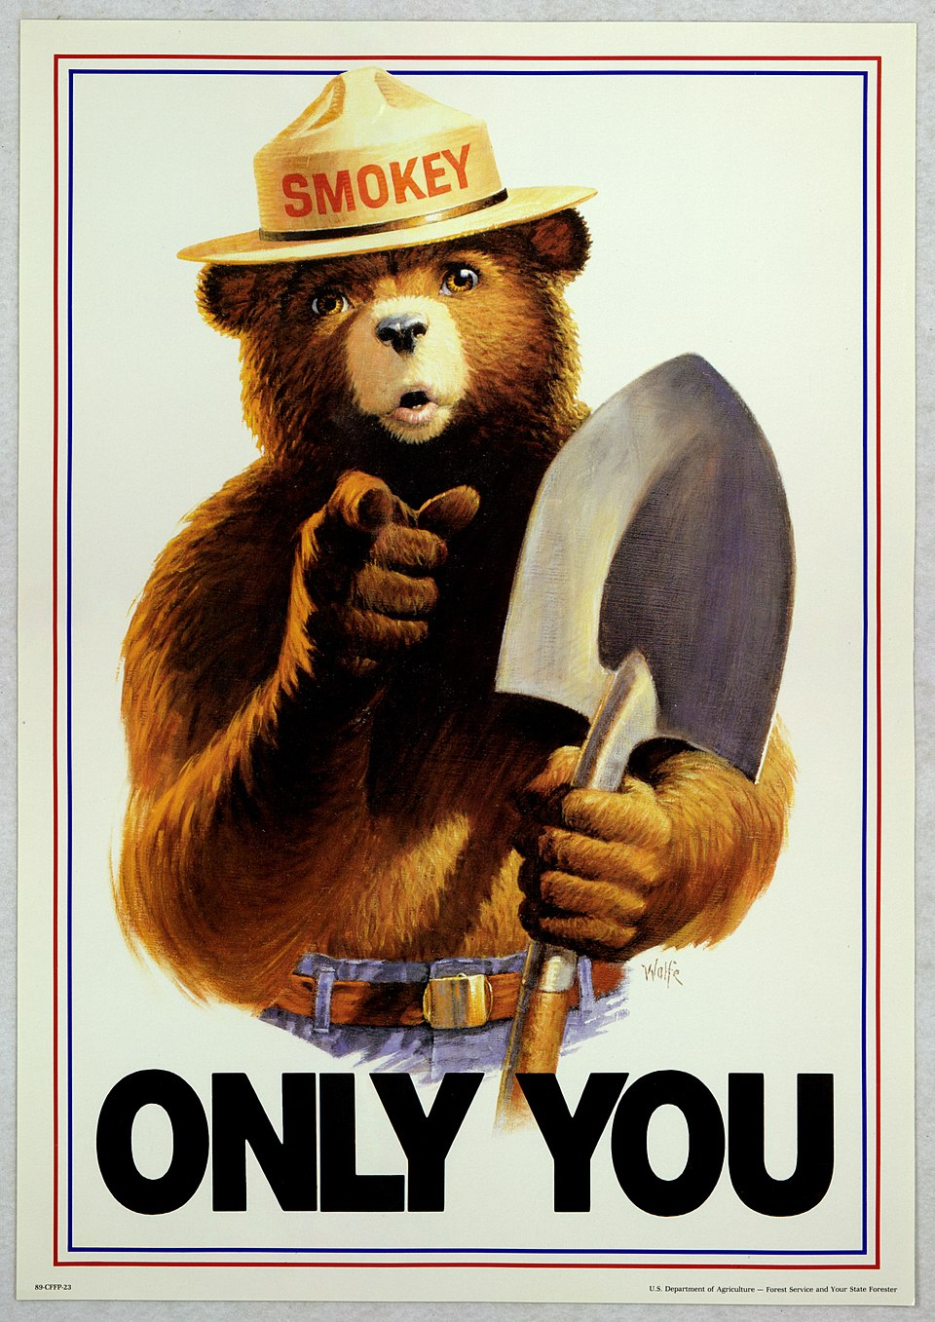
Notes:
Smokey the bear

Slide 19
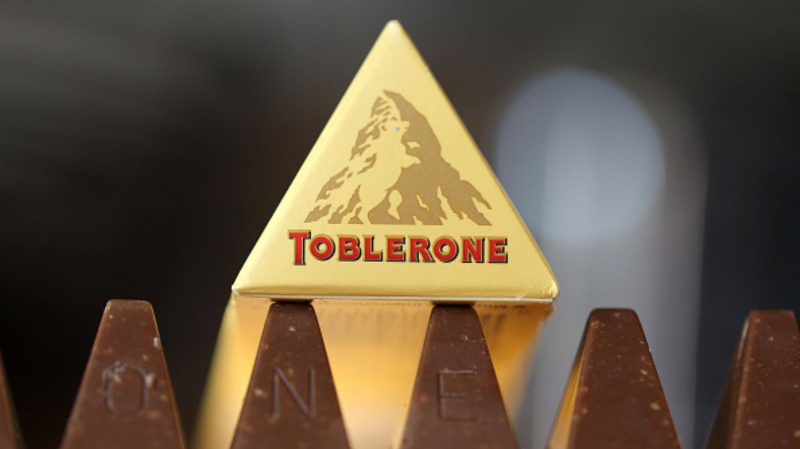
Notes:
Toblerone

Slide 20
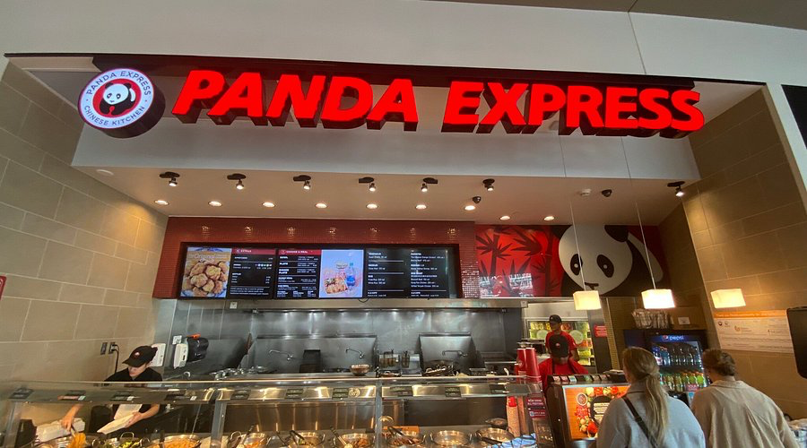
Notes:
Panda Expess

Slide 21
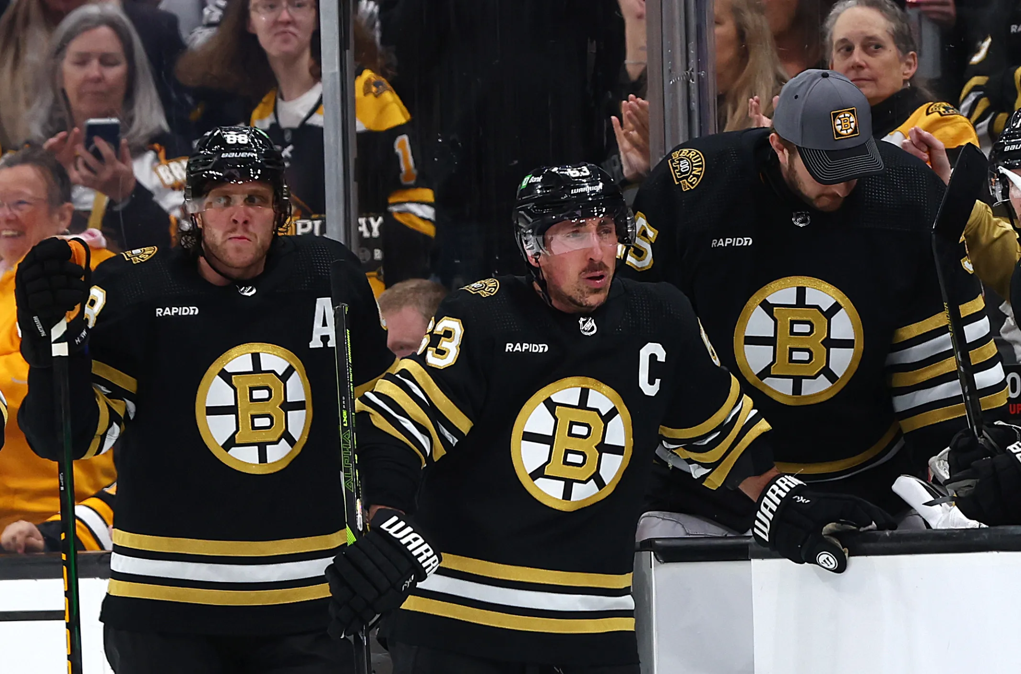
Notes:
Bruins

Slide 22
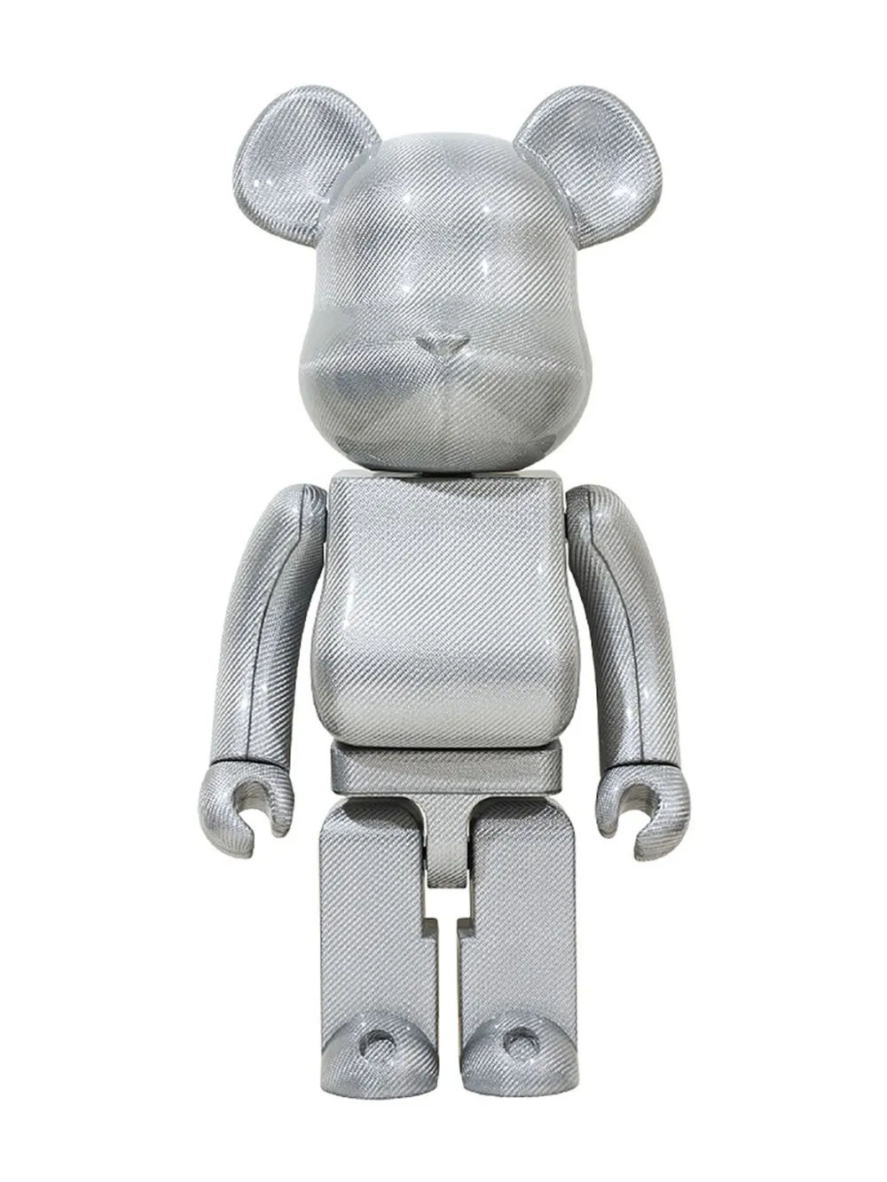
Notes:
Bearbrick

Slide 23
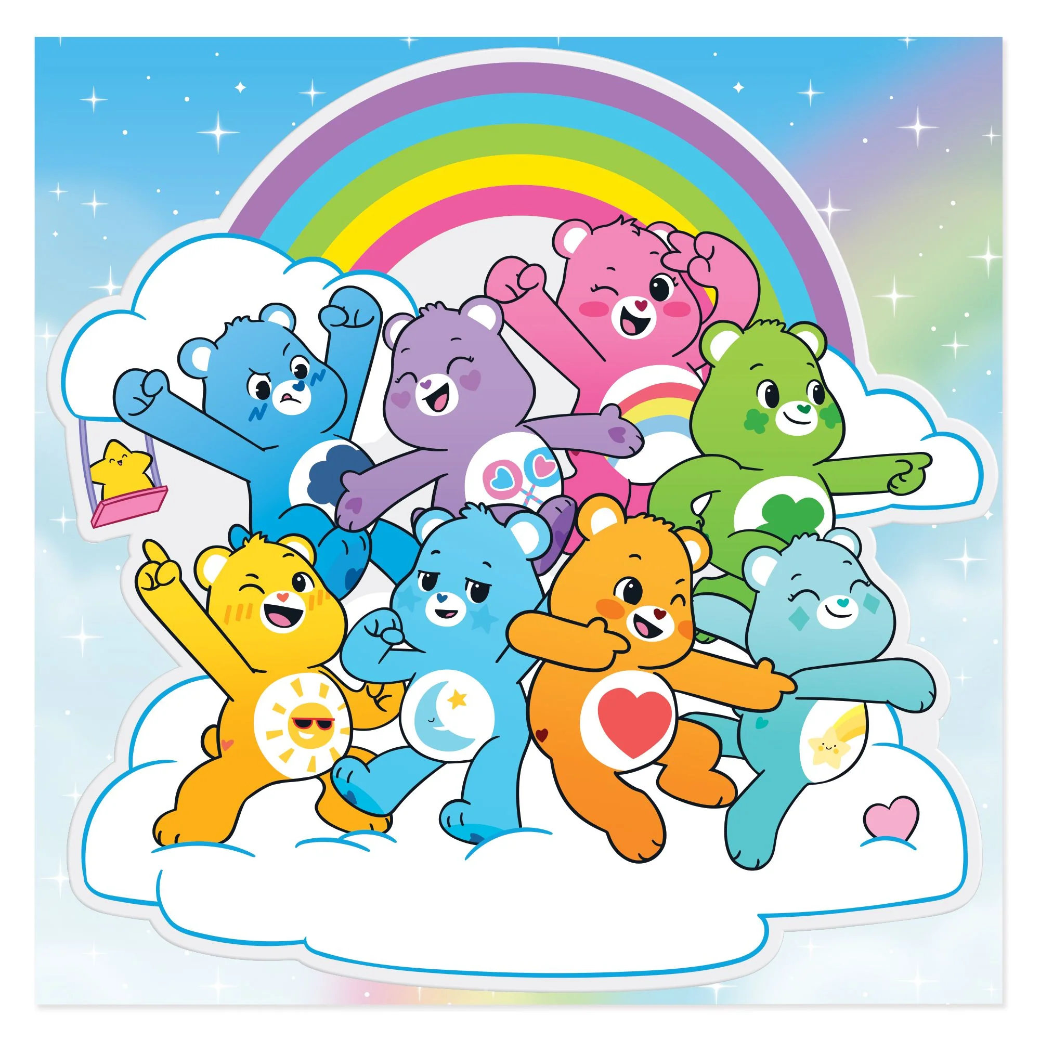
Notes:
Care bears

Slide 24

Notes:
Berlin

Slide 25
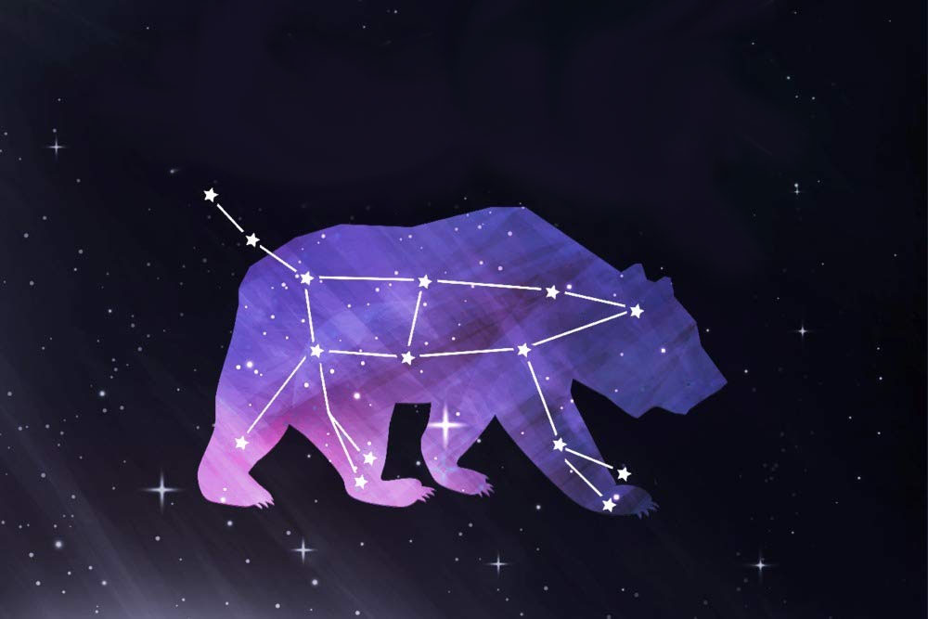
Notes:
Ursa major

Slide 26
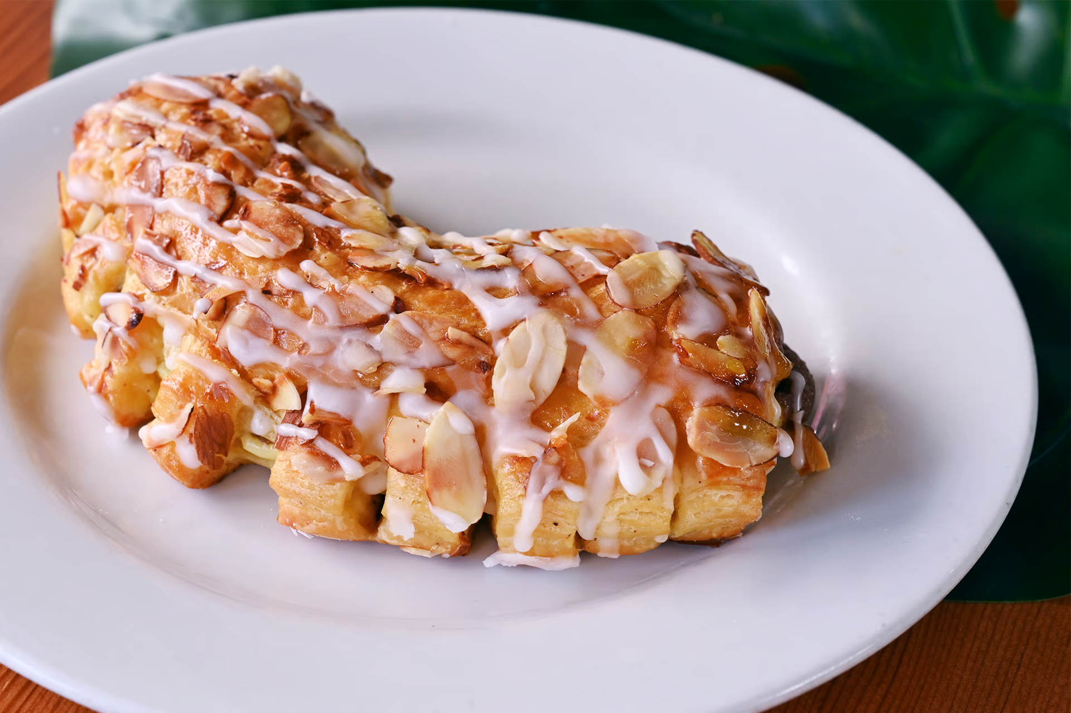
Notes:
Bear claw

Slide 27
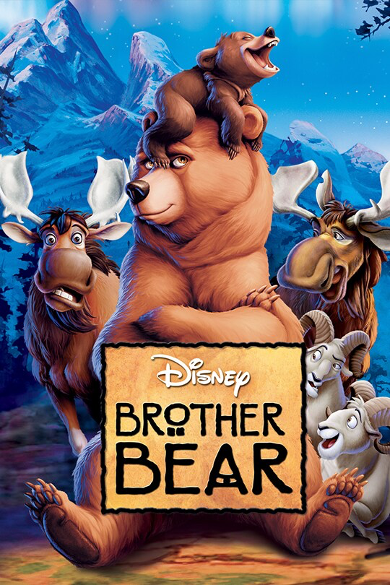
Notes:
Brother Bear

Slide 28
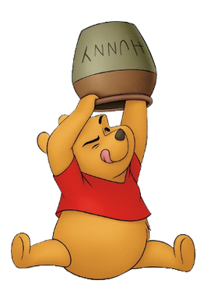

Slide 29

Notes:
Teddy graham

Slide 30
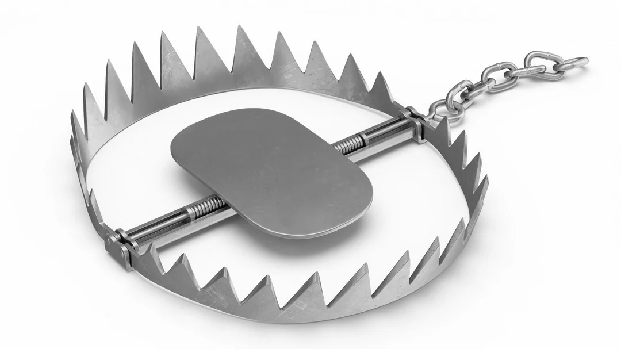
Notes:
Bear trap

Slide 31
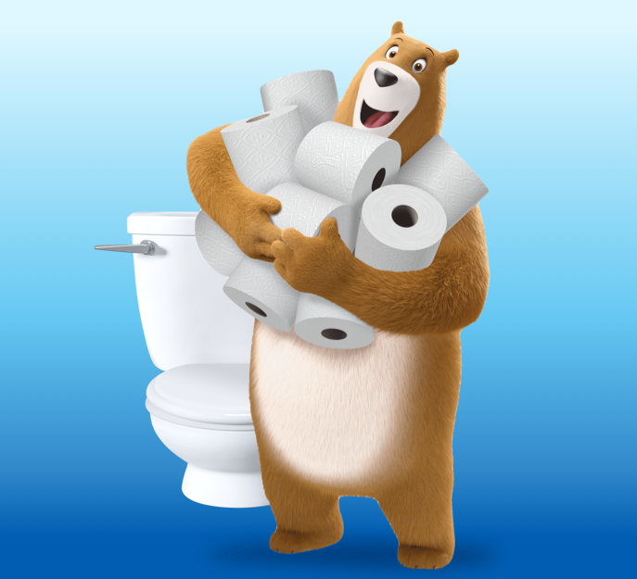
Notes:
Charmin bear

Slide 32
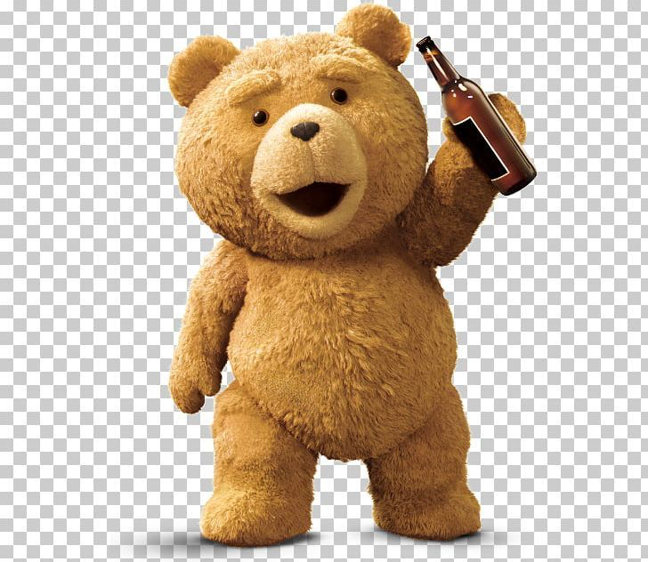
Notes:
Ted

Slide 33

Notes:
The bear

Slide 34
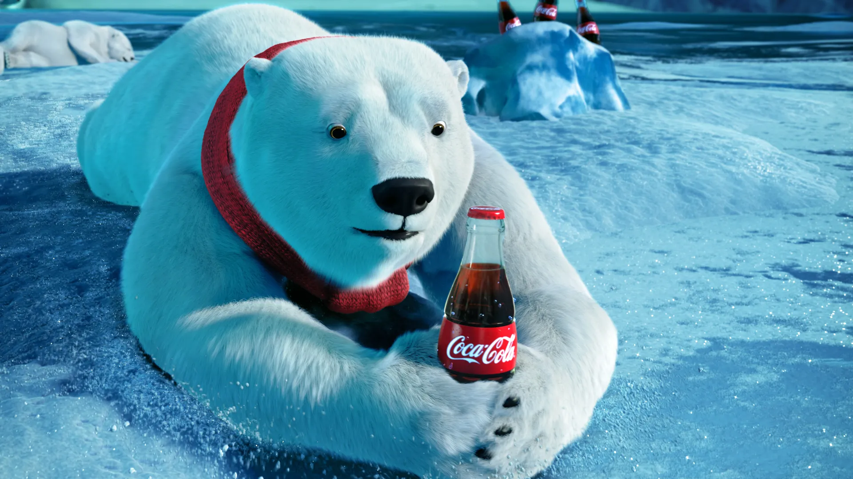
Notes:
Coca Cola Bear

Slide 35
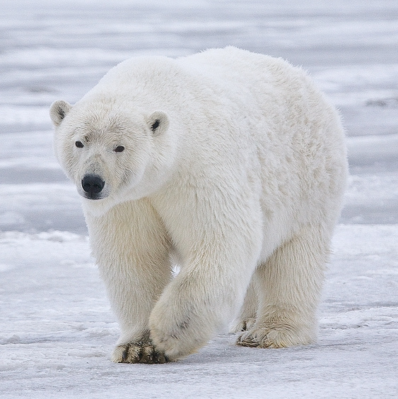
Notes:
Polar bear

Slide 36
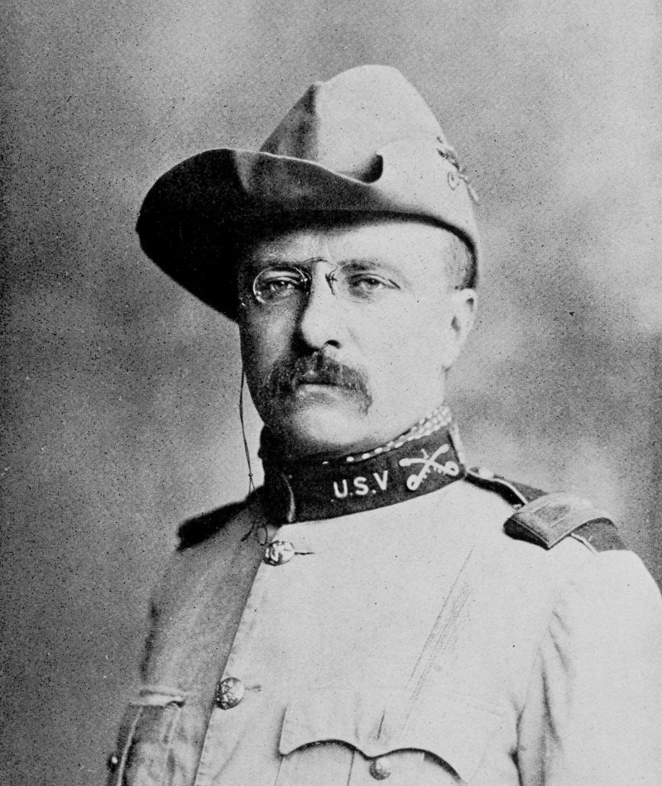
Notes:
Teddy Roosevelt

Slide 37
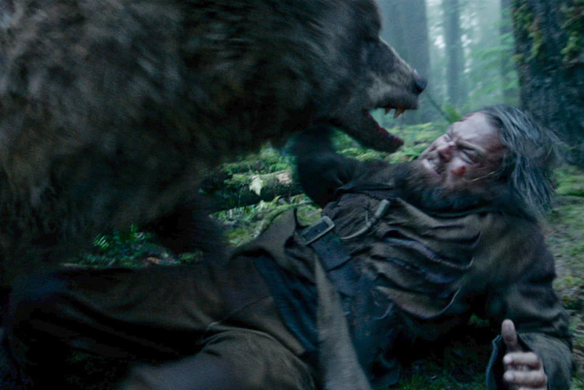
Notes:
The revenant

Slide 38
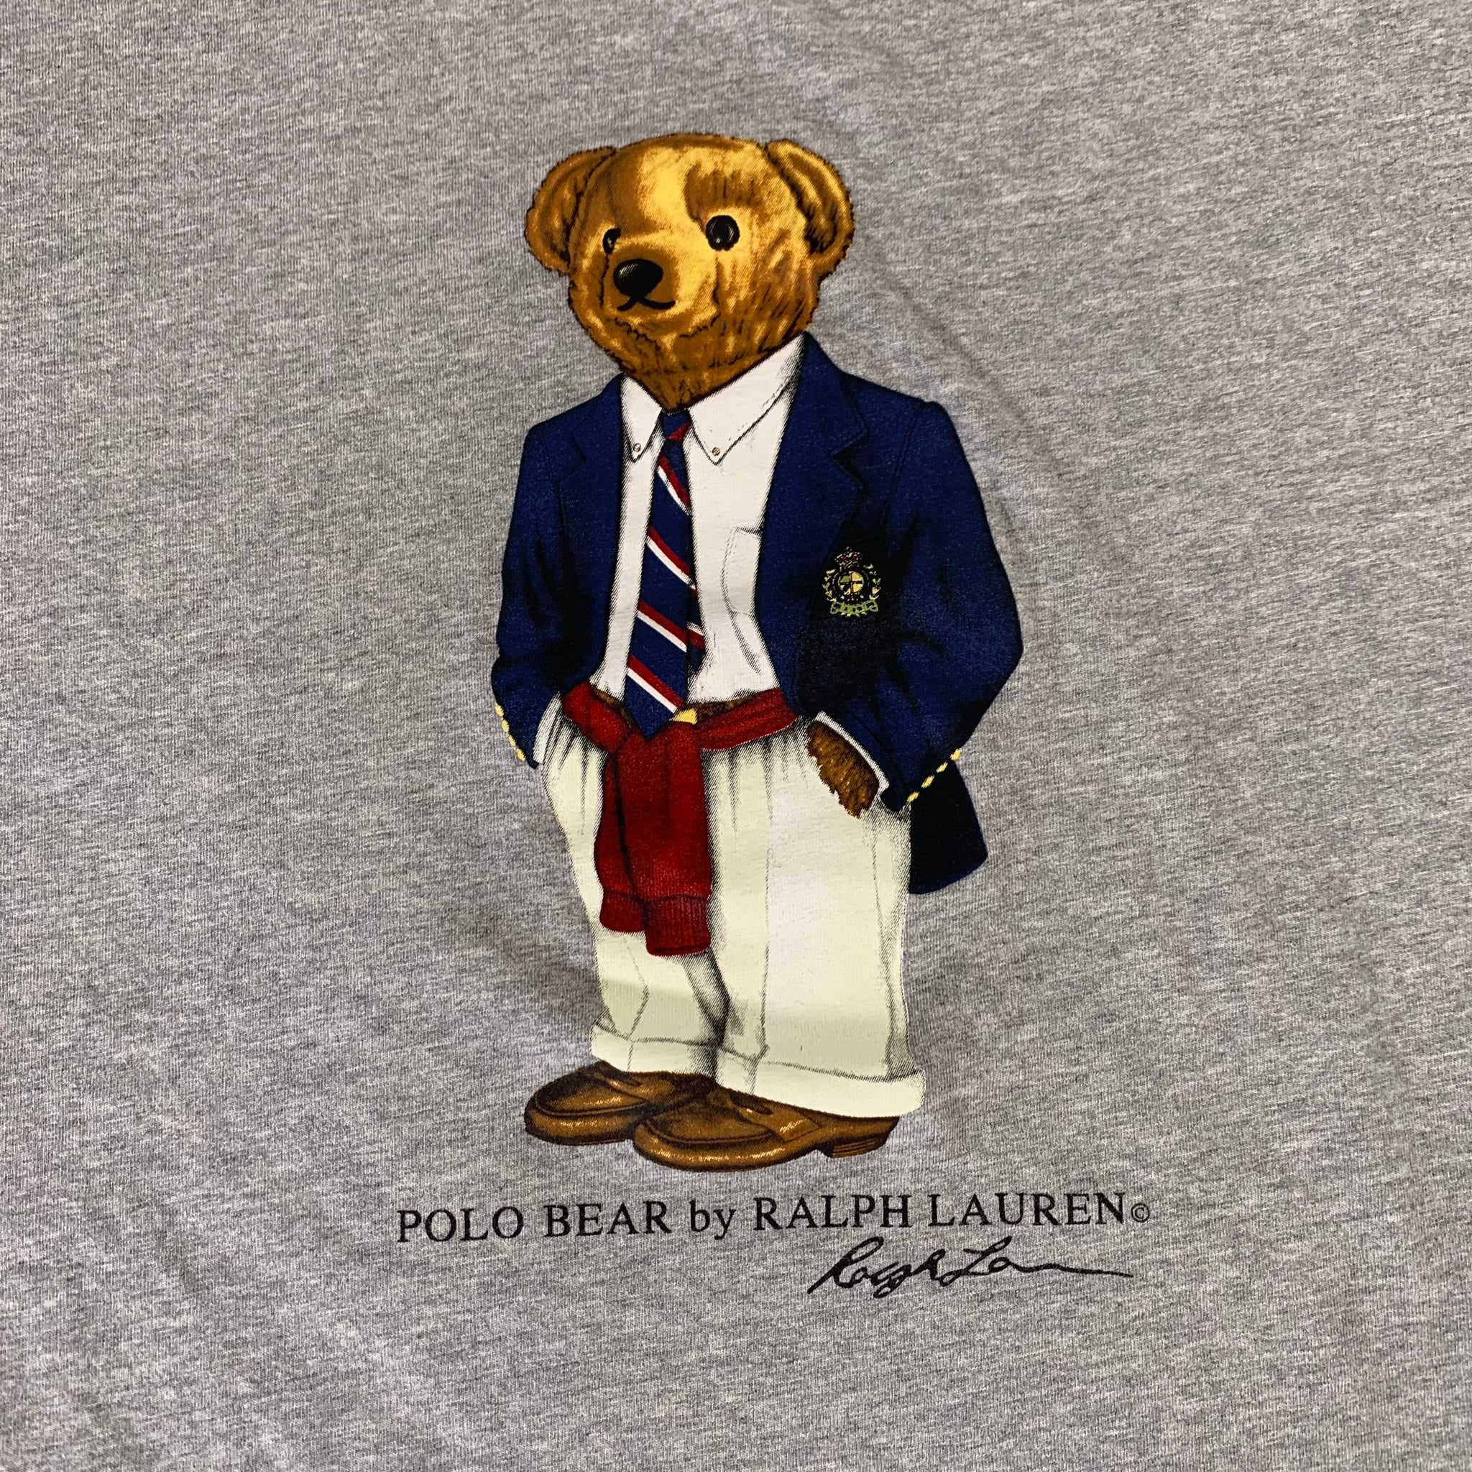
Notes:
Polo Bear

Slide 39
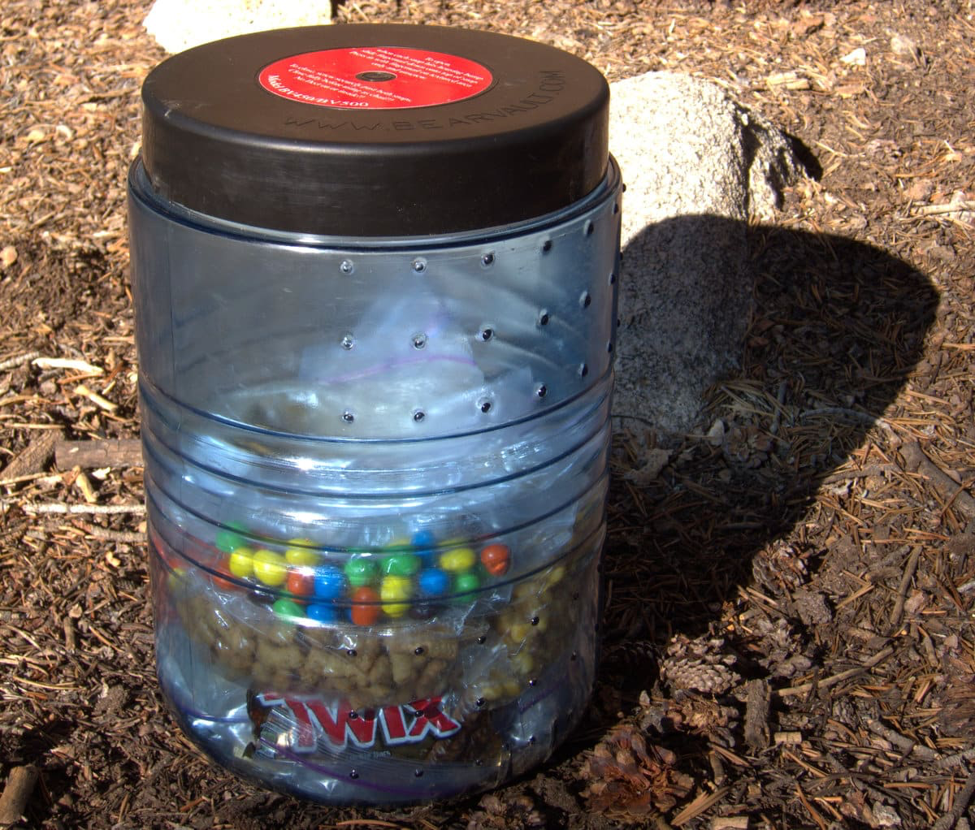
Notes:
Bear can

Slide 40

Notes:
Bear Grylls

Slide 41
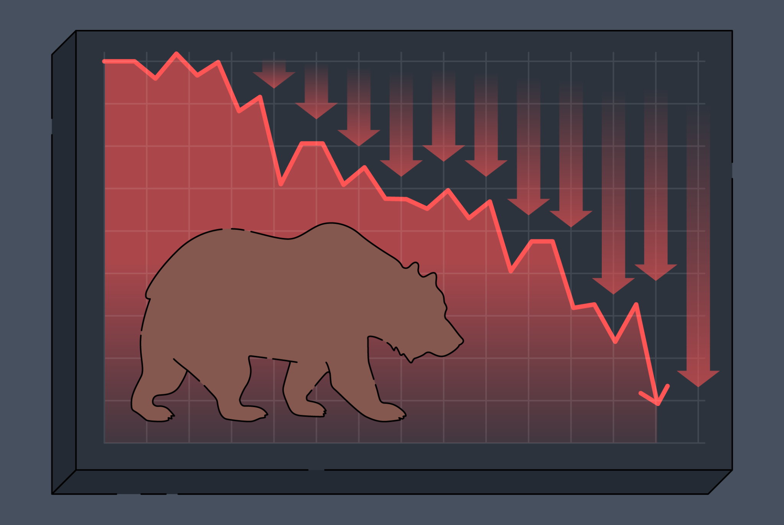
Notes:
Bear market

Slide 42
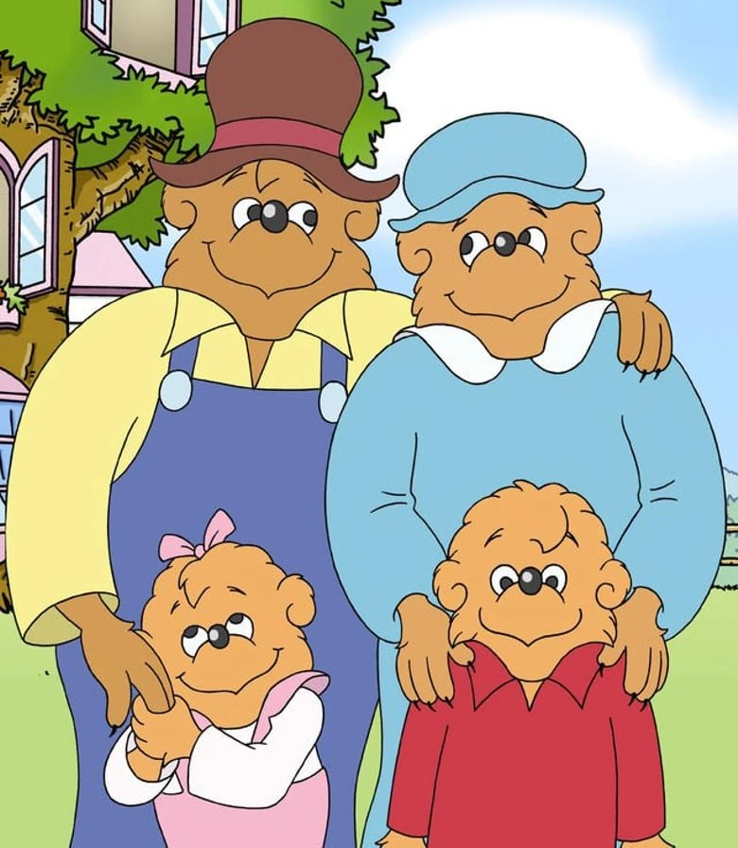
Notes:
The Berenstain Bears

Slide 43
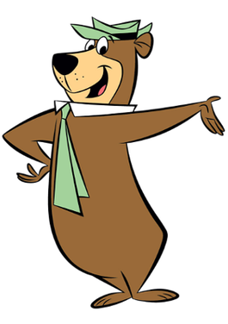
Notes:
Yogi bear

Slide 44
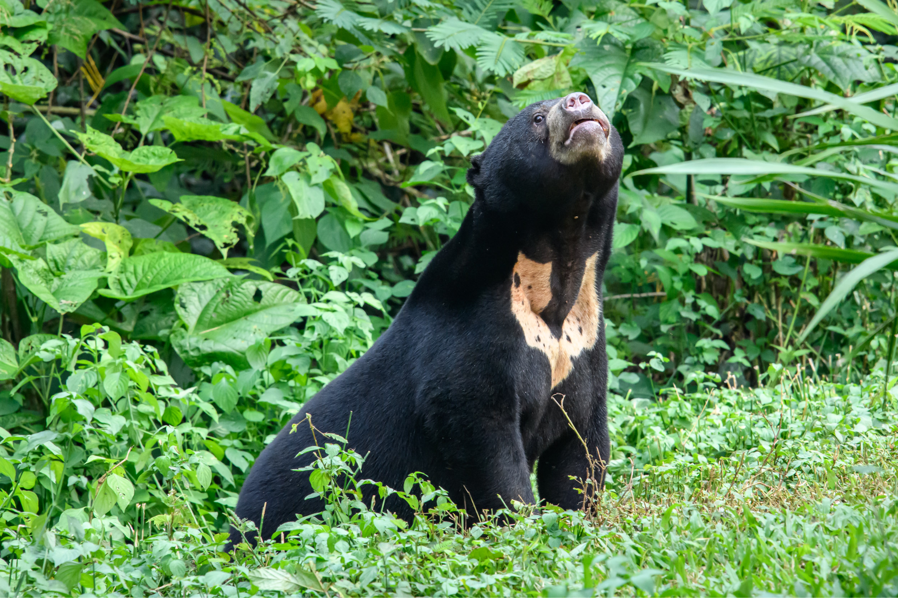
Notes:
Sun bear

Slide 45

Notes:
UCLA

Slide 46
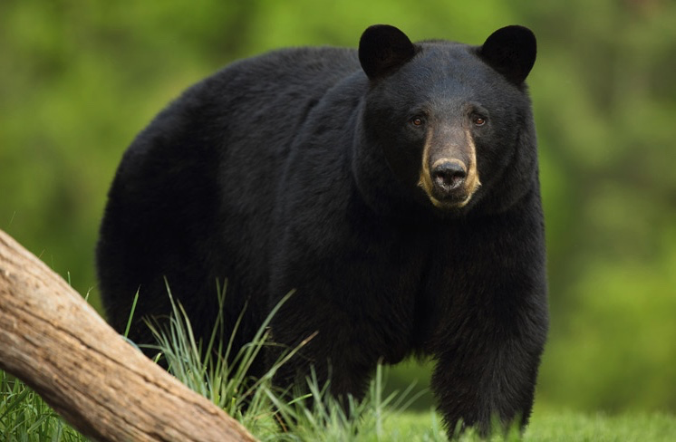
Notes:
Brown bear

Slide 47
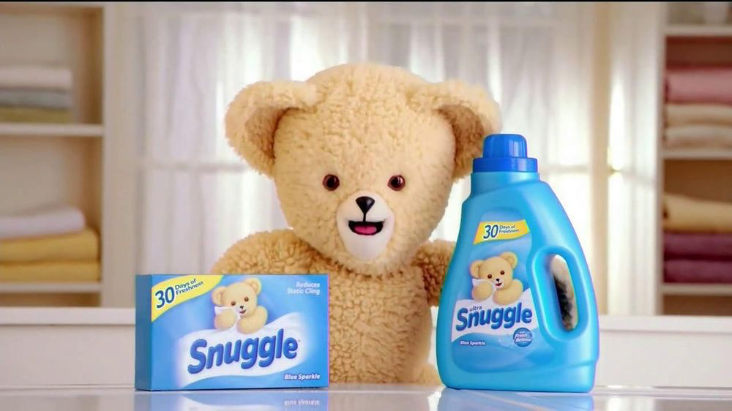
Notes:
Snuggle

Slide 48
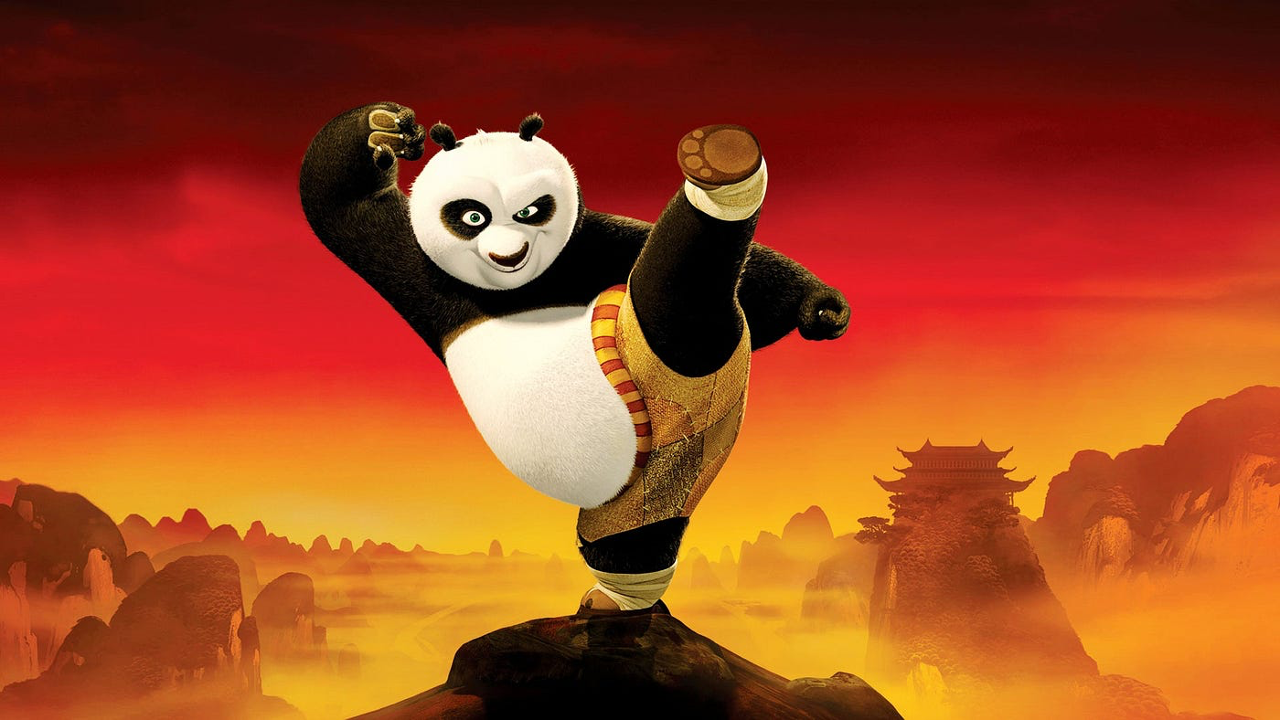
Notes:
Po

Slide 49
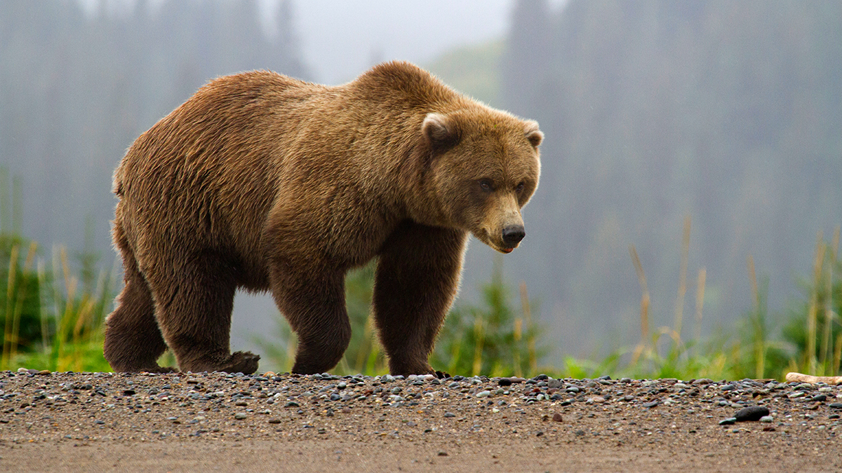
Notes:
Brown/grizzly bear

Slide 50
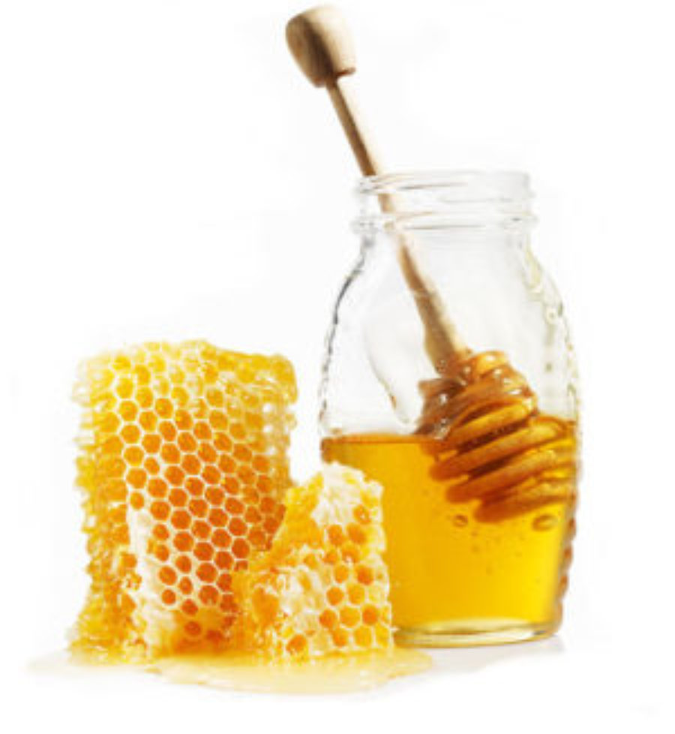
Notes:
honey

